Slide 1


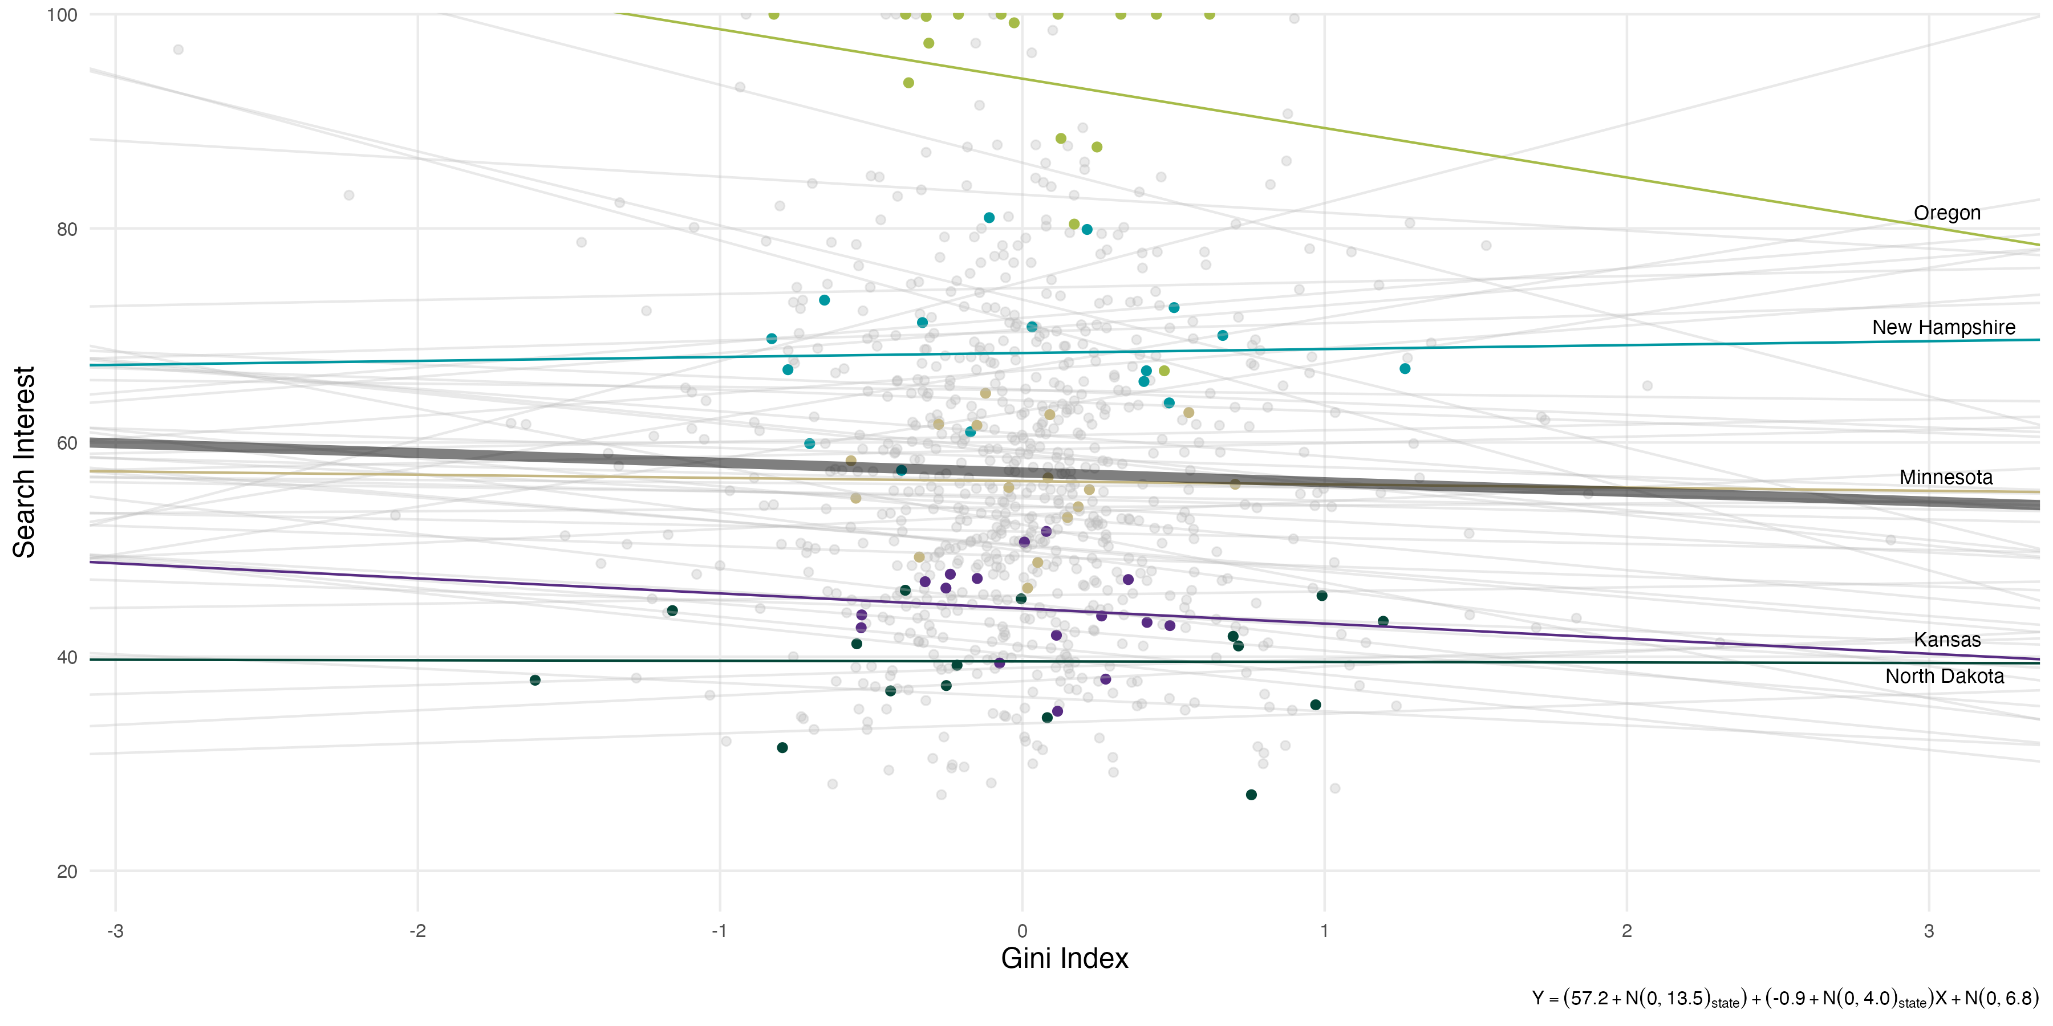
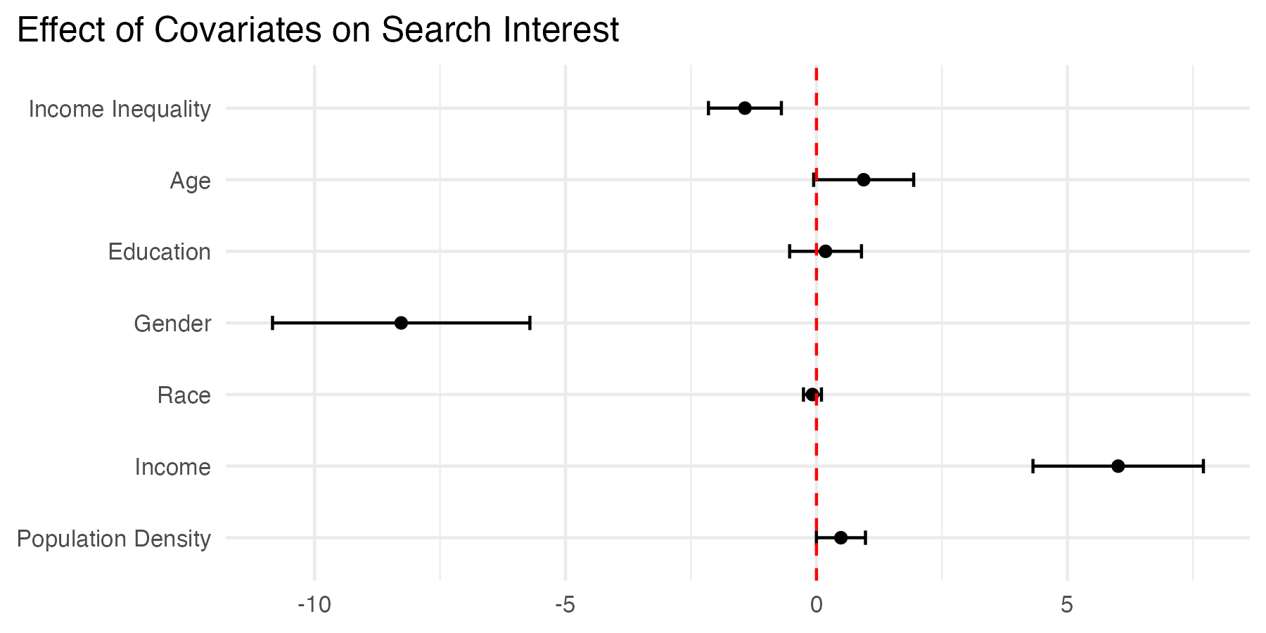
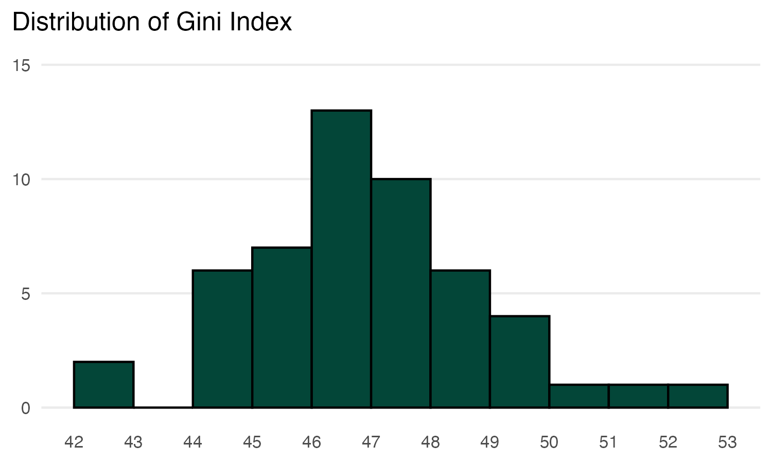
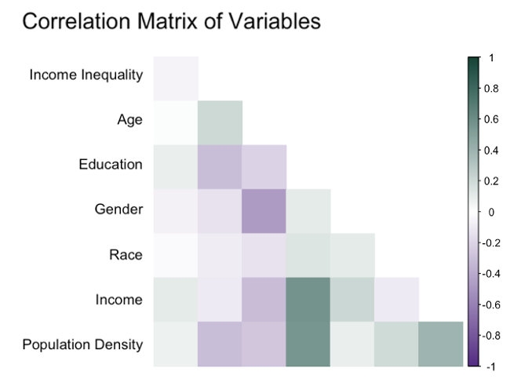
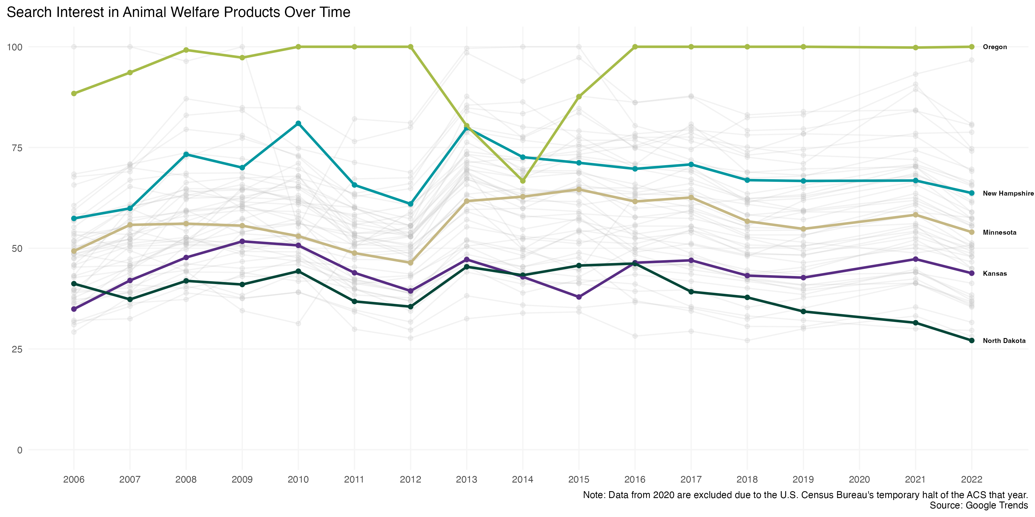
Income Inequality and Search Interest in Animal Welfare Products
Guanjie (Adil) Huang, Dr. Jeff Boichuk Ivey Business School
Introduction
Findings
According to data from Faunalytics (2022), companies slaughter over seventy billion animals for food and subject hundreds of millions of animals to testing per year. This project investigates the relationship between income inequality and interest in animal welfare products using official government sources and Google Trends. According to systems justification theory, higher income inequality may lead people to defend existing social and economic systems, resulting in less interest in animal welfare products.
Consequently, we hypothesize that the Gini index (a measure of income inequality) is inversely related to search interest in keywords related to animal welfare products (i.e., “vegan,” “vegetarian,” “dairy free,” “animal testing,” “cruelty free,” “grass fed,” “free range,” and “cage free”) are inversely related.
Methodology
Aligning with our prediction, we found a significant negative association between income inequality and search interest in animal welfare products (γ₀₁ = -1.53, SE = 0.37, p < .001). Further, this relationship persisted when we added controls into the model (γ₀₁ = -1.43, SE = 0.37, p < .001), suggesting that an increase in income inequality may indeed be correlated with a decrease in the public’s interest in animal welfare products.
Two demographic factors proved to be significant.
Gender displayed a negative relationship with search interest (γ₀₄ = -8.27, SE = 1.31, p < .001).
Income increased search interest in animal welfare products (γ₀₆ = 6.01, SE = 0.86, p < .001).
A linear mixed-effects model was employed to estimate the effects of income inequality and other covariates on search interest. The model accounts for random effects due to variations between states and years.
$$Y_{ij}=γ_{00}+γ_{01}X_{ij}+γ_{02}X_{ij}+u_{0i}+v_{0j}+ε_{ij}$$
where $Y_{ij}$ is search interest for state i in year j, $γ_{00}$ is the overall intercept, $γ_{01}$ and $γ_{02}$ are fixed effects coefficients for income inequality and the vector of control variables (i.e., age, education, gender, race, income, and population density), $u_{0i}$ is random effect for state i, $v_{0j}$ is random effect for year j, and $ε_{ij}$ is a random error term.
Data
We collected data spanning from 2006 to 2022 by leveraging the R programming language and APIs. Data from 2020 are excluded due to the U.S. Census Bureau's temporary halt of the ACS that year. The dataset includes 816 state-year observations (51 states, including D.C., and 16 years). Data sources:
Google Trends: Search interest data for animal welfare keywords.
Social Explorer: Gini index data.
American Community Survey (ACS): Demographic and socioeconomic data for covariates.
Adopting Stephens-Davidowitz’s (2020) approach, we pulled multiple samples from Google Trends, procuring ten state-level samples per year. We used the rwg index to assess the agreement among these samples (James, Demaree, and Wolf 1984), and the rwg index confirmed strong sample consistency (min 0.945, avg 0.995).
Implications
The results suggest income inequality independently influences public interest in animal welfare products, even when controlling for demographic factors. This finding aligns with systems justification theory, where higher inequality leads to rationalizing existing systems and lowering engagement with concepts challenging conventional norms.
References
Faunalytics. (2022). Global animal slaughter statistics & charts: 2022 update. Retrieved from https://faunalytics.org/global-animal-slaughter-statistics-charts-2022-update/
Google Trends. (n.d.). Search interest data for animal welfare keywords. Retrieved from https://trends.google.com/trends/
Hamaker, E. L. and B. Muthén (2020), “The Fixed Versus Random Effects Debate and How It Relates to Centering in Multilevel Modeling,” Psychological Methods, 25 (3), 365-379.
James, L. R., R. G. Demaree, and G. Wolf (1984), “Estimating Within-Group Interrater Reliability with and without Response Bias,” Journal of Applied Psychology, 69 (1), 85-98.
Social Explorer. (n.d.). Gini index data. Retrieved from https://www.socialexplorer.com/
Stephens-Davidowitz, S. (2020), “Google Searches Can Help Us Find Emerging Covid-19 Outbreaks,” NY Times, available at: https://www.nytimes.com/2020/04/05/opinion/coronavirus-google-searches.html.
U.S. Census Bureau. (n.d.). American Community Survey (ACS): Demographic and socioeconomic data for covariates. Retrieved from https://www.census.gov/programs-surveys/acs/

